Slide 1
Apache Kafka

Slide 2
Agenda
Kafka Overview
Kafka Console Commands
Kafka Producer and Consumer Demo
Kafka Producer and Consumer Demo using Spring Cloud
Data Processing using Kafka Streams

Slide 3
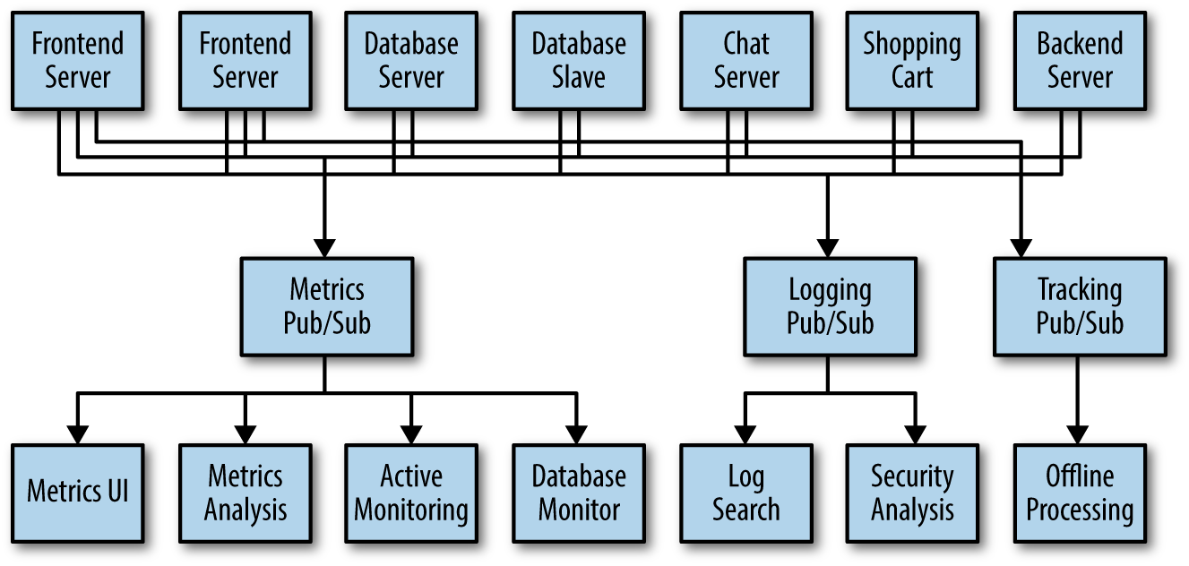
Pub/Sub System

Slide 4
How Kafka is different from other Messaging Systems?
A modern distributed system that runs as a cluster and can scale
A true storage system built to store data which is replicated, persistent, and can be kept around as long as you like
Stream processing capabilities in Kafka let you compute derived streams and datasets dynamically off of your streams with far less code
Handles multiple Producers, multiple Consumers, disk based retention, Scalable and High performance

Slide 5
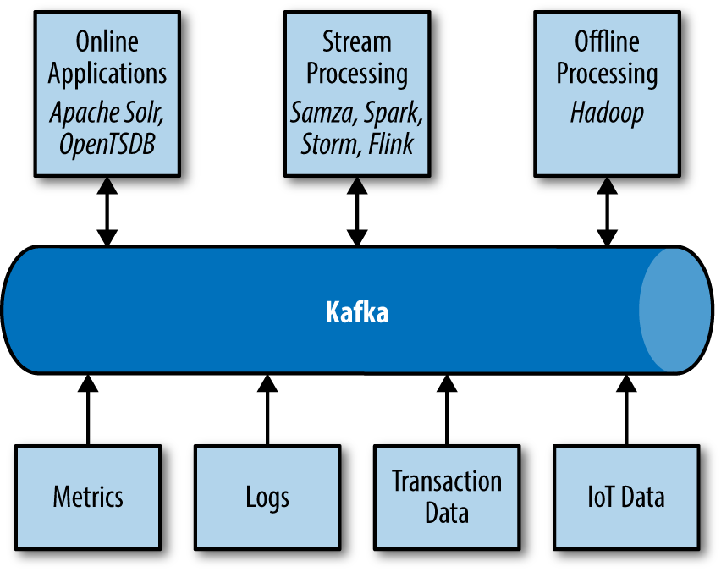
Data Ecosystem using Kafka

Slide 6
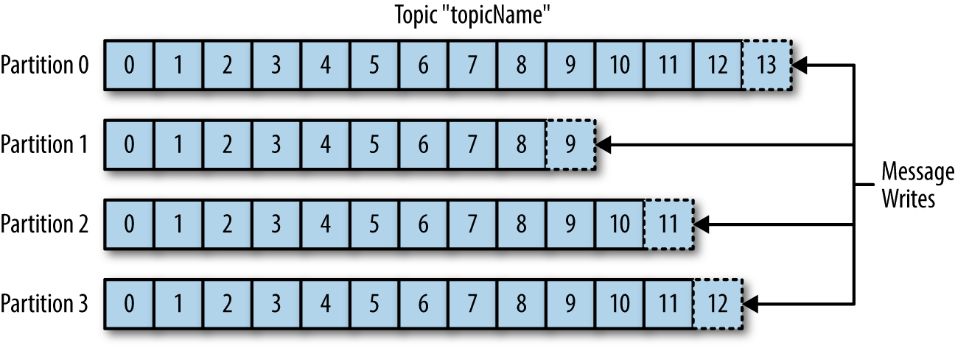
Kafka Topic

Slide 7
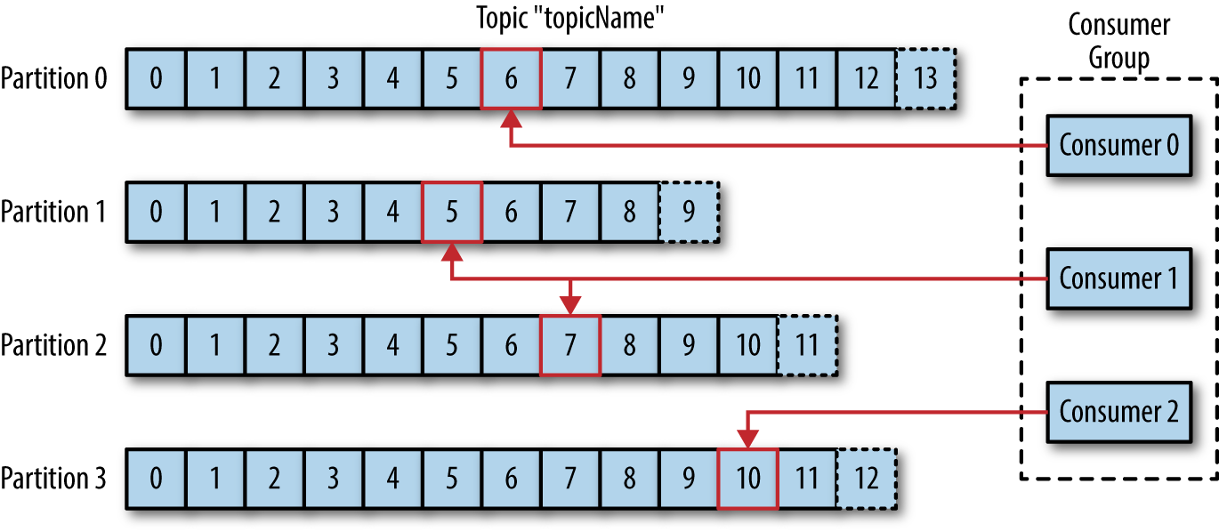
Kafka Producers and Consumers

Slide 8
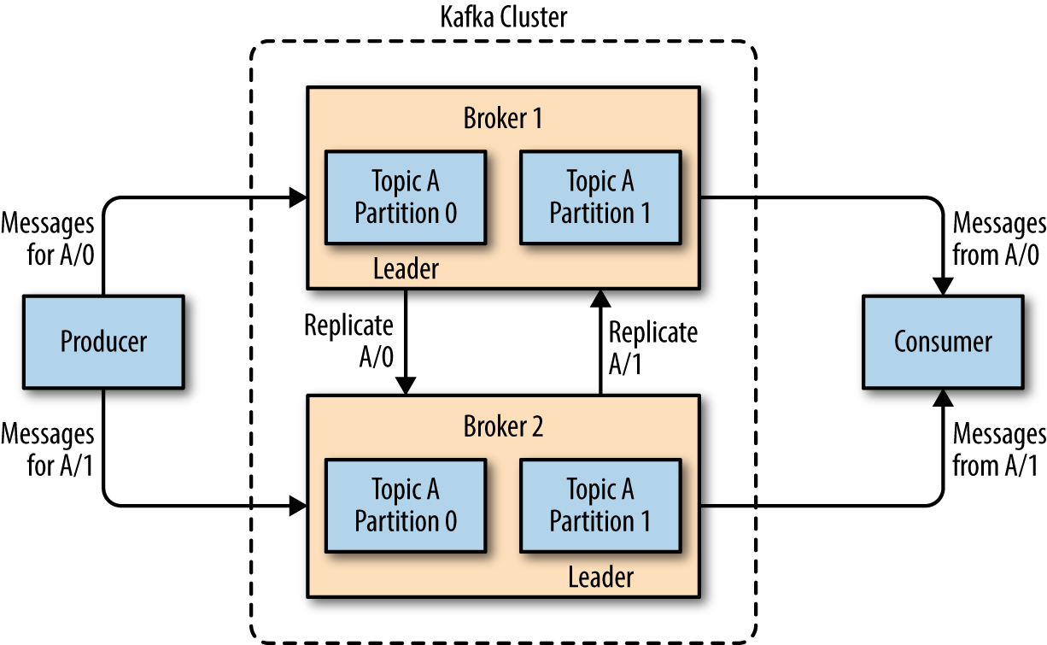
Kafka Cluster

Slide 9
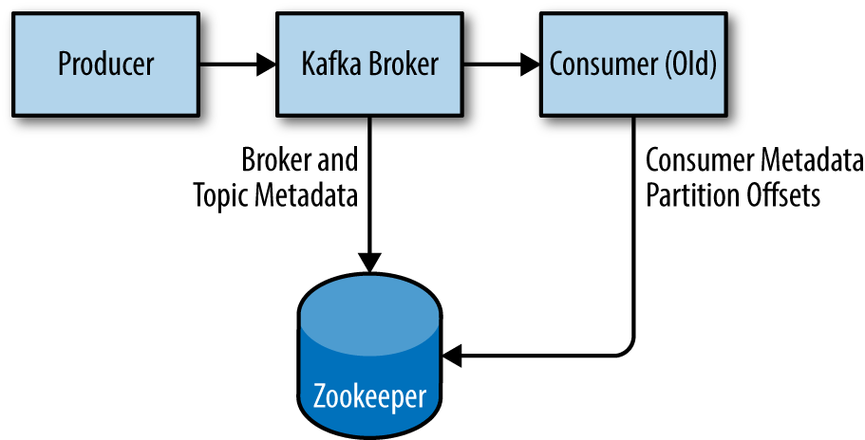
Zookeeper

Slide 10
Demo

Slide 11
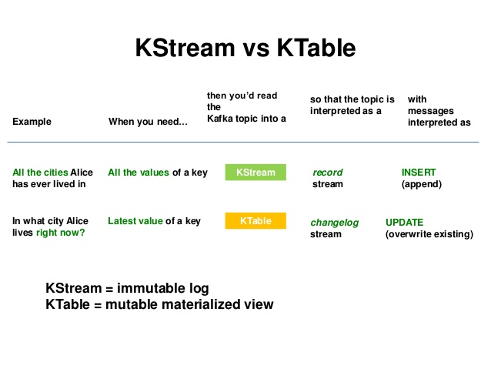
KStream VS KTable

